Slide 1
The Entity-Relationship Model
Part-3
Rodica Neamtu
rneamtu@wpi.edu

Slide 2
More Elements in ER Model
Key Constraints
Cardinality Constraints
Weak Entities
Subclass Entities (ISA Relationships)
Principles for Good Design

Slide 3
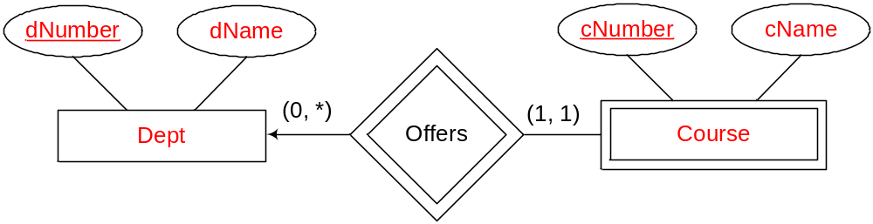
Weak Entity Sets
An entity set that does not have a primary key is referred to as a weak entity set
  Its attributes are not enough to form a key
The existence of a weak entity set depends on the existence of an identifying entity set
  It must relate to the identifying entity set via a total, one-to-many relationship set from the identifying to the weak entity set
Course number is unique only within the department
Weak entity set
Identifying entity set

Slide 4
Weak Entity Sets
Discriminator (or partial key) of a weak entity set
  The set of attributes that uniquely identify a weak entity given its identifying entity
Primary key of a weak entity set
  The composition of the primary key of the identifying entity set + the weak entity set’s discriminator
Identifying entity has to exist for each weak entity
  Cannot have a course without a corresponding department
(dNumber, cNumber) is the primary key for Course
discriminator

Slide 5
Representing a Weak Entity Set
Weak entity set is represented by double rectangles
Weak relationship (supporting relationship) is represented by double diamonds
Weak relationship is one-many

Slide 6
Again: It Depends on Your Application/Assumptions
If you assume the course number is unique within a department
  “Course” → is a weak entity set
If you assume the course number is unique across all departments
  “Course” → is a strong entity set
offers
Course
Stating your assumptions in text is very important !!!

Slide 7

Revisit Previous Example …
pName
pNumber
Product
sName
cName
Supplier
in
Consumer
sLoc
consumes
cLoc
supplies
Contract
Weak Entity
price
qty
Same supplier cannot make more than one contract with the same consumer for the same product !!!

Slide 8

A Better Design…
pName
pNumber
Product
sName
cName
Supplier
in
Consumer
sLoc
consumes
cLoc
supplies
Contract
Weak Entity
Date
price
qty
Same supplier can now make contract with the same consumer for the same product but on different dates

Slide 9
Another Design …
pName
pNumber
Product
sName
cName
Supplier
in
Consumer
sLoc
consumes
cLoc
supplies
Contract
Contract Id
Strong Entity
price
qty

Slide 10

Exercise 1
Book-Publisher
Database

Slide 11
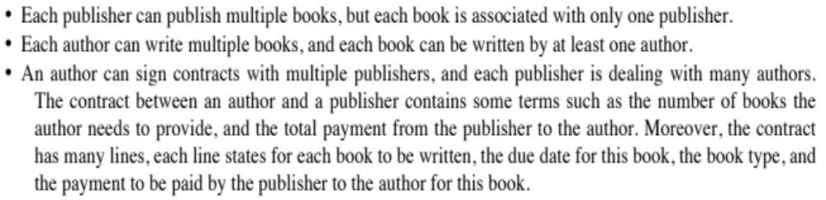
Scenario
The application keeps track of authors through their ID (unique for each author), name, DoB, address, multiple phone numbers. We keep track of publishers through name (unique for each publisher), address, start year, phone number. For books we record ISBN (unique for each book), title, publishing date, type and number of pages.
many authors

Slide 12
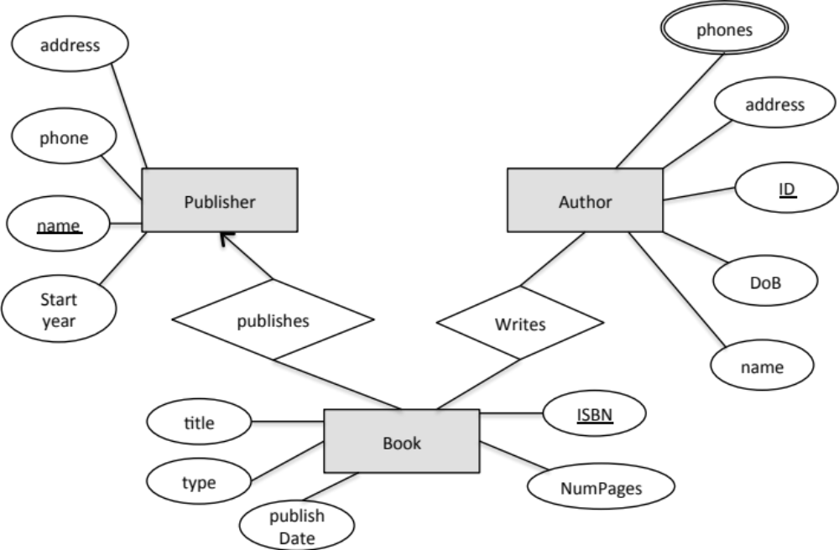
Book-Publisher DB
What remains is the “Contracts” and their details

Slide 13
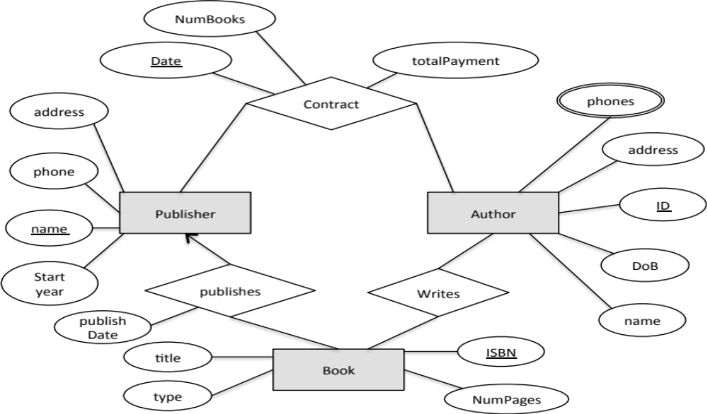

Book-Publisher DB
What about contract lines ???
We modeled the contract between “Authors” & “Publishers”
We made the contract “date” part of the key → now an author can have multiple contracts with the same publisher over time.

Slide 14

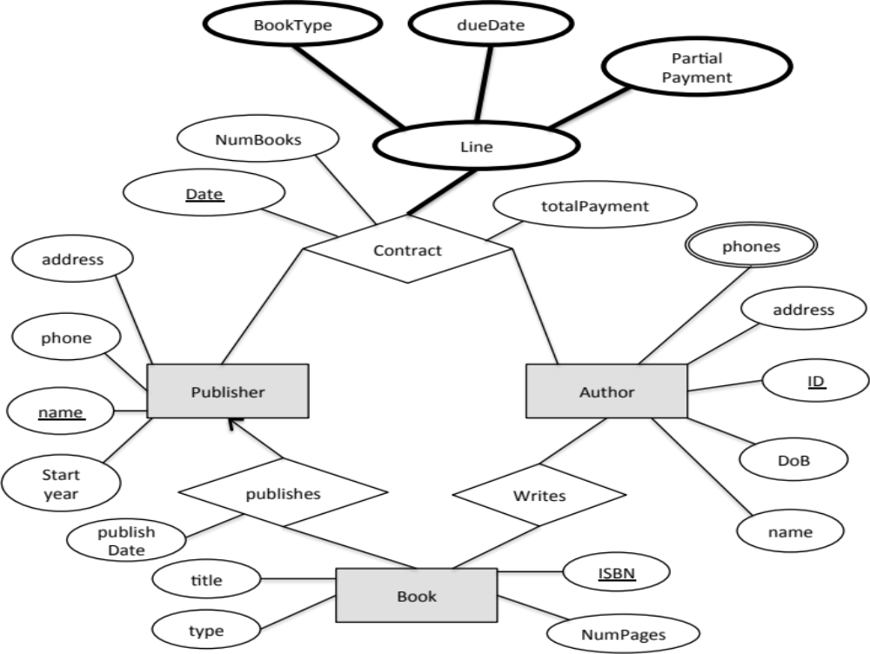
Book-Publisher DB
This means a contract has only one line

Slide 15
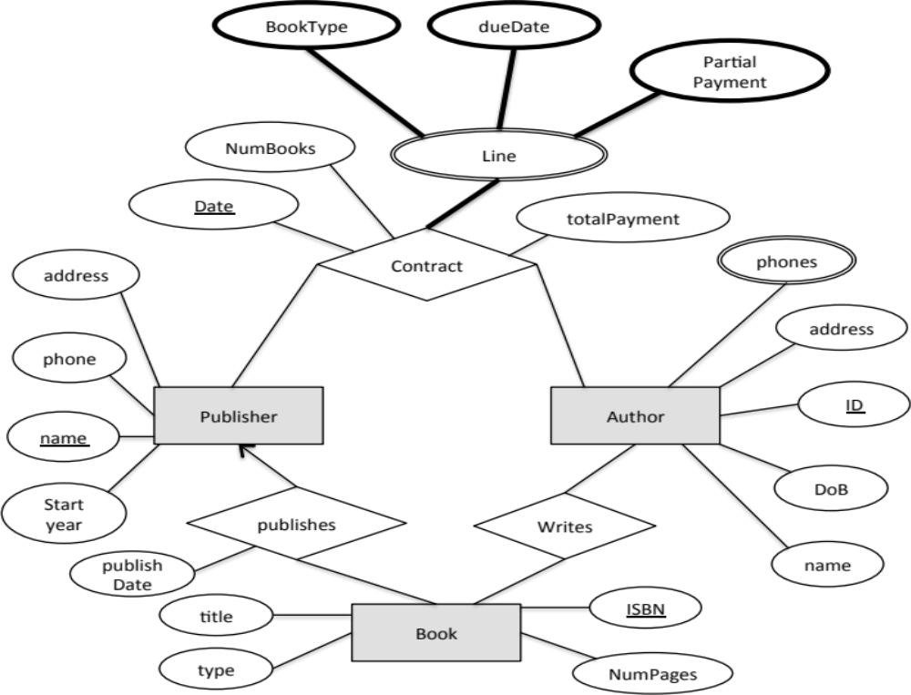
Book-Publisher DB
Not in the ER standards

Slide 16
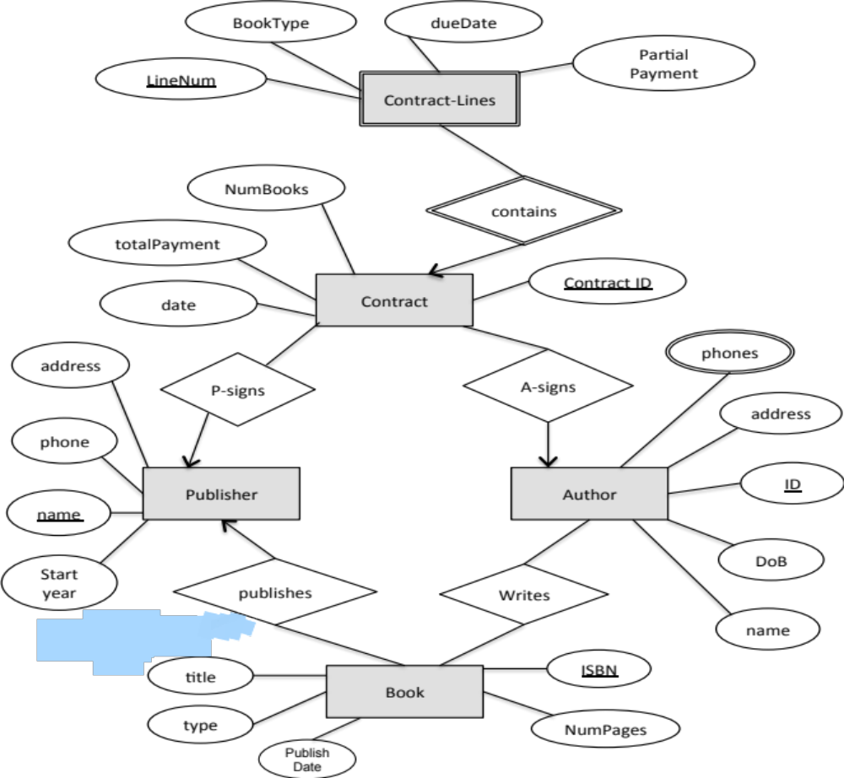

Book-Publisher DB
It is more practical that “LineNum” is unique only within a contact

Slide 17
Exercise 2
Design Hotel database

Slide 18
Example: Hotel Database
A Hotel has many branches
  Hotel → name, logo, address of HQ, Tel., manager, star rating
  Branch → Id, address, Tel., Total capacity
Each branch has many rooms with different types and numbers. A room type defines
  Room size, Number of beds
  Has TV or not, Has Balcony or not
  These attributes of the room depend on its type
Guests can stay in a hotel for a period of time
  Guests have unique ID, name, address, Tel.
  We need to capture, the length of the stay, start date, end date, money paid

Slide 19
Ver. 1
HQ Add.
Name
Manager
Tel.
Rating
Hotel
Num
Num Beds
Capacity
Has TV
Capacity
Room
Has Balcony
Tel.
Branch
Type
Add.
ID
Observations:
Room type is modeled as attribute (causes redundancy)
Room number, is it numeric like 1001? If so, how come to be unique across branches?

Slide 20
Ver. 2
HQ Add.
Name
Manager
Tel.
Rating
Num Beds
Hotel
Capacity
Has TV
Type
Has Balcony
Type
Capacity
Tel.
Branch
Room
Add.
Num
ID
Observations:
Lets add relationships

Slide 21
Ver. 3
HQ Add.
Name
Manager
Tel.
Rating
Num Beds
Hotel
Capacity
Has TV
Type
Has Balcony
has
Type
Capacity
Of type
Tel.
contains
Branch
Room
Add.
Num
ID
Common mistake: Do not add “Branch ID” as an attribute to “Room” entity set. It is already captured by the weak relationship “contains”.
Observation: Not all relationships of “Room” are “supporting” relationships. Only the one that completes the key.

Slide 22
Back to the Requirements
A Hotel has many branches
  Hotel → name, logo, address of HQ, Tel., manager, star rating
  Branch → Id, address, Tel., Total capacity
Each branch has many rooms with different types and numbers. A room type defines
  Room size, Number of beds
  Has TV or not, Has Balcony or not
Guests can stay in a hotel for a period of time
  Guests have unique ID, name, address, Tel.
  We need to capture, the length of the stay, start date, end date, money paid

Slide 23
Ver. 4
HQ Add.
Name
Manager
Tel.
Rating
Num Beds
Hotel
Capacity
Has TV
Type
Has Balcony
has
Type
Capacity
Of type
Tel.
contains
Branch
Room
Add.
Num
Observations:
“Stay” attributes should not be part of “Guest”
ID
Start date
Length of stay
Guest
End date
Money Paid
ID
Name
Add.
Tel.

Slide 24
Ver. 5
HQ Add.
Name
Manager
Tel.
Rating
Num Beds
Hotel
Capacity
Has TV
Type
Has Balcony
has
Type
Capacity
Of type
Tel.
contains
Branch
Room
Add.
Num
ID
Start date
Length of stay
Observations:
Still not quite right..
“Stays-in” 1-M or M-M??
(Guest should be able to stay in diff. rooms)
Stays in
End date
Money Paid
Guest
ID
Name
Add.
Tel.

Slide 25
Ver. 6
HQ Add.
Name
Manager
Tel.
Rating
Num Beds
Hotel
Capacity
Has TV
Type
Has Balcony
has
Type
Capacity
Of type
Tel.
contains
Branch
Room
Add.
Num
ID
Start date
Length of stay
Observations:
Not done yet…
In this model, a guest cannot stay in the same room over diff visits!!!
Stays in
End date
Money Paid
Guest
ID
Name
Add.
Tel.

Slide 26
Ver. 7
HQ Add.
Name
Manager
Tel.
Rating
Num Beds
Hotel
Capacity
Has TV
Type
Has Balcony
has
Type
Capacity
Of type
Tel.
contains
Branch
Room
Add.
Num
ID
Start date
Length of stay
Observations:
Start_date ← part of key
Length of stay ← derived attribute
Stays in
End date
Money Paid
Guest
ID
Name
Add.
Tel.

Slide 27
More Elements in ER Model
Key Constraints
Cardinality Constraints
Weak Entities
Subclass Entities (ISA Relationships)
Principles for Good Design

Slide 28
ISA Relationship Types
Similar to “subclass” concept in Object-Oriented languages
Entity sets share some common attributes but differ in others
Sometimes called “Specialization/Generalization”
Example
  Students can be UGStudents or GradStudents
    UGStudents take undergrad Classes
    GradStudents can be TAs or RAs
    GradStudents are advised by Professors

Slide 29
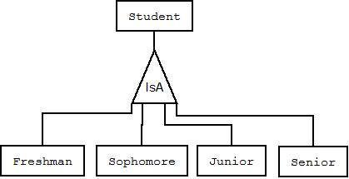
ISA Example
All attributes of “student” are inherited in the other entity sets
Each entity set, e.g., “Freshman”, can have its own additional attributes

Slide 30
ISA Relationship Types (Cont’d)
Top-down design process
  Build entities with the common attributes, then build sub-entities with distinctive attributes from other entities in the set
These sub-entities become lower-level entity sets that have attributes or participate in relationships that do not apply to the general higher-level entity set
In ERD, represented by a triangle component labeled ISA (E.g. customer “is a” person)
Attribute inheritance
  Lower-level entity set inherits all the attributes and relationship participation of the higher-level entity set to which it is linked

Slide 31
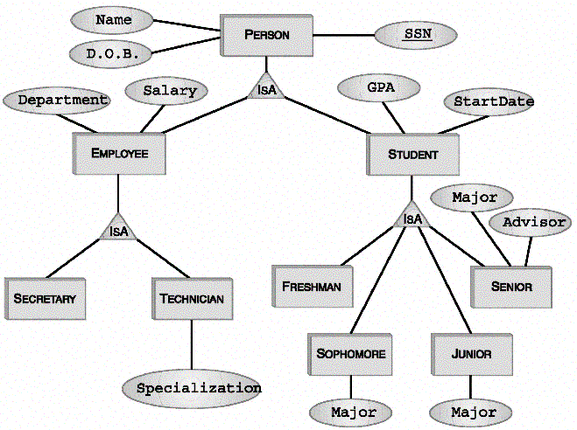
More Complete Example
Attributes of Person:
SSN, Name, DOB
Attributes of Student:
SSN, Name, DOB, GPA, StartDate
Attributes of Technician:
SSN, Name, DOB, Salary, Department, Specialization

Slide 32
Multiple ISA Relationships
Can have multiple specializations of an entity set based on different features
Permanent Emp
ISA
Temporary Emp

Slide 33
ISA Relationship: Constraints
Three types of constraints
  Membership: To which entity set an entity belongs
  Overlapping: Can an entity belong to multiple subclasses or not
  Completeness: Does each super entity have to belong to one (or more) subclasses

Slide 34
ISA Relationship: Membership
Constraint on which entities can be members of a given lower-level entity set
    Denoted in ERD on the ISA edge
Year
Year = 1
Year = 4
Year = 2
Year = 3

Slide 35
ISA Relationship: Overlapping
Constraint on whether or not entities may belong to more than one lower-level entity set within a single generalization.
  Disjoint
    An entity can belong to only one lower-level entity set
  Overlapping
    An entity can belong to more than one lower-level entity set
  Denoted in ERD by writing “disjoint” or “overlapping” inside the ISA triangle, by default → “disjoint”
disjoint

Slide 36
ISA Relationship: Completeness
Specifies whether or not an entity in the higher-level entity set must belong to at least one of the lower-level entity sets within a generalization
  Total : An entity must belong to one of the lower-level entity sets
  Partial: An entity need not belong to one of the lower-level entity sets
Total

Slide 37
ISA Relationship: Multiplicity
ISA relationship is always 1-1 (even though its notation is arrows without heads)

Slide 38
ISA Relationship: Keys
Key of sub-entities is inherited from the super entities
SSN is the primary key for Person, Student, Employee, Freshman, Technician, and all other sub-entities

